Slide 1


I’ve been doing some syncing…
Paul Lammertsma
CTO, Pixplicity

Slide 2
Sync Adapter
Notion of a “sync adapter”
Assumes that it transfers data between device storage and a server
Assumes your data is associated with an account
Assumes your server storage requires login access
Takes care of:
Background execution when device has connectivity
Bundling sync operations between apps

Slide 3

Sync Adapter
Your learning goals:
SyncAdapter
AccountManager
AccountAuthenticator
My goals:

Slide 4
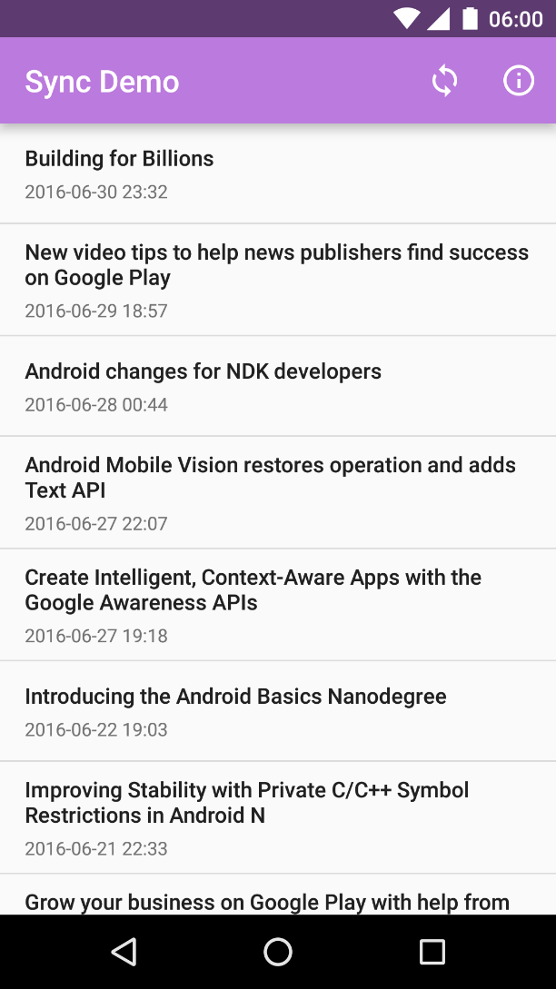
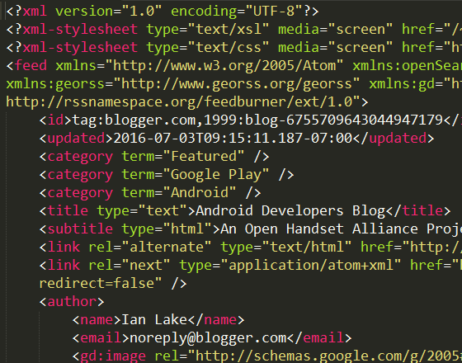

ListView of blog posts
Fetches data when app is opened
UI
Atom XML feed (Android Developers Blog)
Network
ze internet

Slide 5
Bad idea #1:
No caching
UI
Network
ze internet

Slide 6
Bad idea #1:
No caching
UI
Bad idea #2:
No separation of concerns
ActivityA
FragmentX
FragmentY
Network
ze internet

Slide 7
UI
Network
ze internet

Slide 8
UI
ContentResolver.query()
ContentProvider
ContentResolver.insert()
Network
ze internet

Slide 9
CursorLoader
UI
ContentObserver
ContentResolver.query()
ContentProvider
onCreate(): fetch data
ContentResolver.insert()
Network
Bad idea #3:
Stale data
Bad idea #4:
Assumes internet connection
ze internet

Slide 10
CursorLoader
UI
ContentObserver
ContentResolver.query()
Bad idea #5:
Called frequently
ContentProvider
Bad idea #6:
Bandwidth/CPU starvation
ContentResolver.insert()
Service
Network
CONNECTIVITY_CHANGE
BroadcastReceiver
ze internet

Slide 11
CursorLoader
UI
ContentObserver
ContentResolver.query()
ContentProvider
ContentResolver.insert()
SyncAdapter
Network
Android Framework
Hey, this would be a great moment to synchronize!
ze internet

Slide 12
Sync Demo

Slide 13
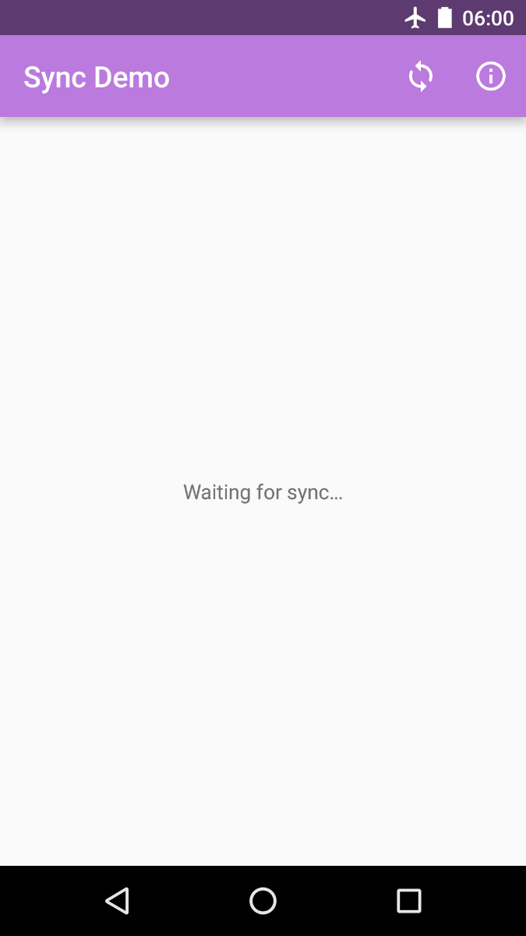


Sync Demo

Slide 14
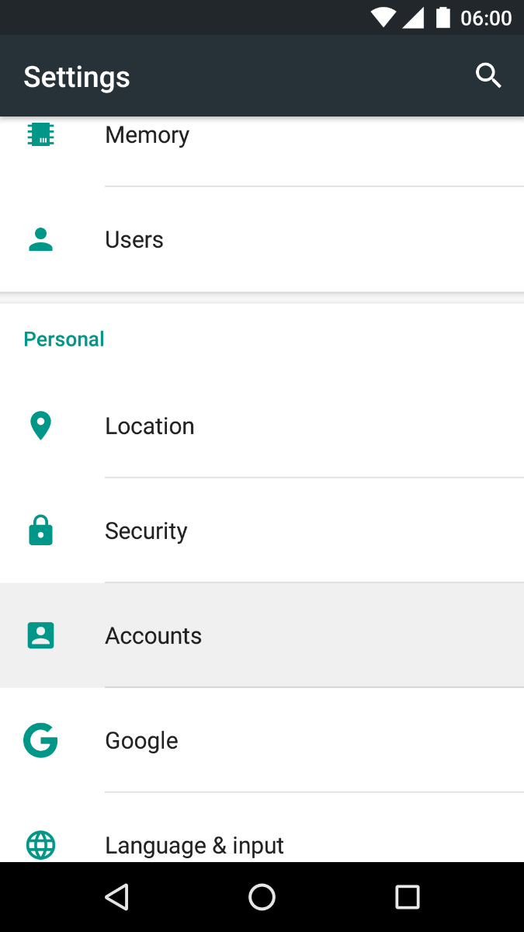
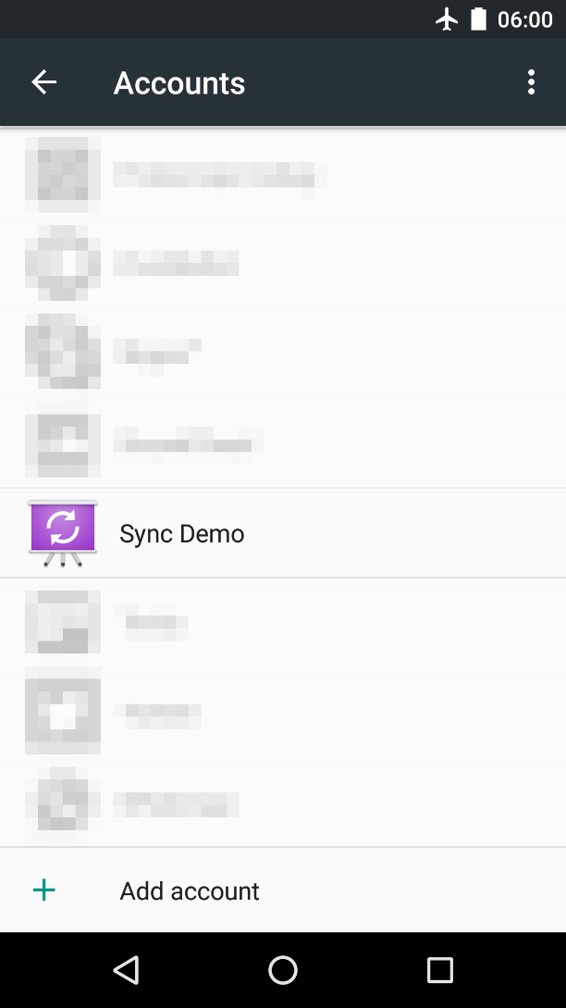
Android Settings

Slide 15
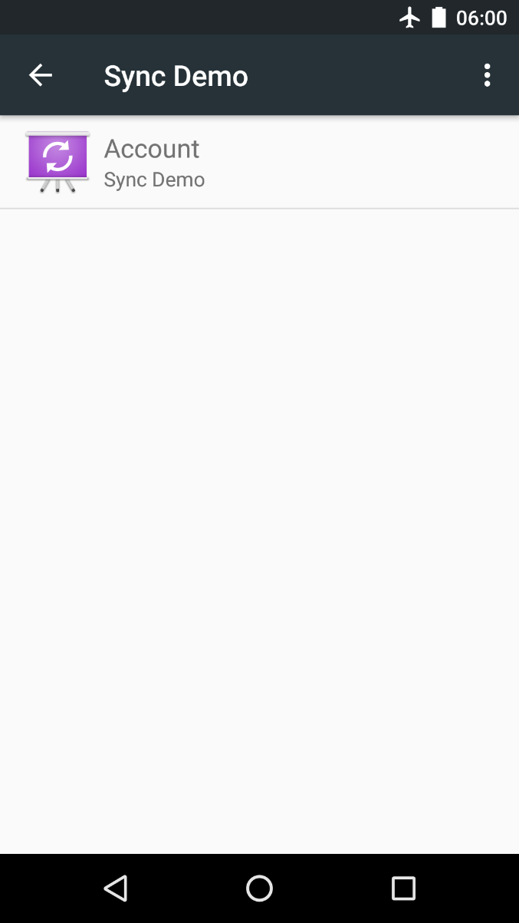
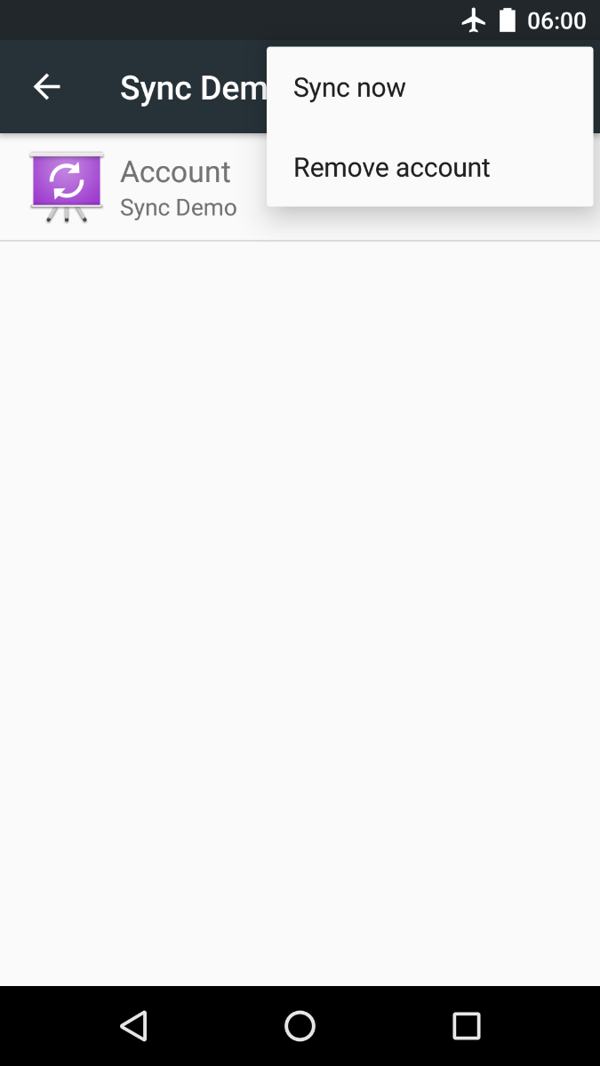
Android Settings

Slide 16
When does it sync?
On demand
When you tell it to, for instance because:
Refresh button was hit
Local data needs to be sent
Server data has changed (think GCM)
When the user tells it to through Android settings
At regular intervals

Slide 17
CursorLoader
UI
ContentObserver
ContentResolver.query()
ContentProvider
ContentResolver.insert()
SyncAdapter
Network
Android Framework
Hey, this would be a great moment to synchronize!
ze internet

Slide 18
CursorLoader
UI
ContentObserver
ContentResolver.query()
ContentProvider
ContentResolver.insert()
SyncService
SyncAdapter
Network
Binds to service
Android Framework
ze internet

Slide 19
CursorLoader
UI
ContentObserver
ContentResolver.query()
ContentProvider
ContentResolver.insert()
SyncService
SyncAdapter
Network
Binds to services
Android Framework
AccountAuthenticatorService
ze internet

Slide 20
SyncAdapter
AccountAuthenticatorService
AndroidManifest.xml
<!-- Required for fetching feed data. --> <uses-permission android:name="android.permission.INTERNET"/>
<!-- Required to enable our SyncAdapter after it's created. --> <uses-permission android:name="android.permission.WRITE_SYNC_SETTINGS"/>
<!-- Required because we're manually creating a new account. --> <uses-permission android:name="android.permission.AUTHENTICATE_ACCOUNTS"/>

Slide 21
AndroidManifest.xml
<service android:name=".sync.SyncService" />

Slide 22
AndroidManifest.xml
<service android:name=".sync.SyncService" >
<intent-filter> <action android:name=" "/> </intent-filter>
<meta-data android:name=" " android:resource=" "/> </service>
<!-- This service implements our SyncAdapter. It needs to be exported, so that the system sync framework can access it. --> <service android:name=".sync.SyncService" android:exported="true">
<intent-filter> <action android:name=" "/> </intent-filter>
<meta-data android:name=" " android:resource=" "/> </service>
<!-- This service implements our SyncAdapter. It needs to be exported, so that the system sync framework can access it. --> <service android:name=".sync.SyncService" android:exported="true"> <!-- This intent filter is required. It allows the system to launch our sync service as needed. --> <intent-filter> <action android:name="android.content.SyncAdapter"/> </intent-filter>
<meta-data android:name=" " android:resource=" "/> </service>
<!-- This service implements our SyncAdapter. It needs to be exported, so that the system sync framework can access it. --> <service android:name=".sync.SyncService" android:exported="true"> <!-- This intent filter is required. It allows the system to launch our sync service as needed. --> <intent-filter> <action android:name="android.content.SyncAdapter"/> </intent-filter> <!-- This points to a required XML file which describes our SyncAdapter. --> <meta-data android:name="android.content.SyncAdapter" android:resource="@xml/syncadapter"/> </service>

Slide 23
SyncService.java
public class SyncService extends Service {
private SyncAdapter mSyncAdapter = null;
/** * Creates {@link SyncAdapter} instance. */ @Override public void onCreate() { super.onCreate(); mSyncAdapter = new SyncAdapter(getApplicationContext(), true); }
…

Slide 24
SyncService.java
…
/** * Return Binder handle for IPC communication with {@link SyncAdapter}. * * <p>New sync requests will be sent directly to the SyncAdapter using this channel. * * @param intent Calling intent * @return Binder handle for {@link SyncAdapter} */ @Override public IBinder onBind(Intent intent) { return mSyncAdapter.getSyncAdapterBinder(); }
}

Slide 25
Launched by the system
Lives as long as the SyncAdapter is running
Allows system to bind to SyncAdapter

Slide 26
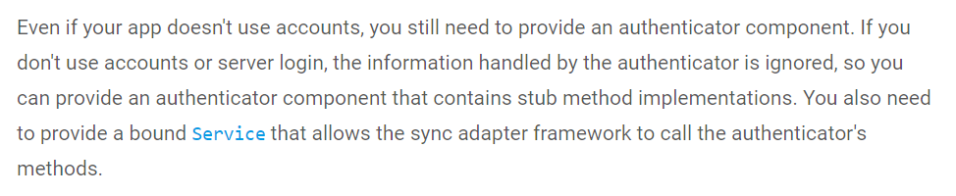

Android expects you to provide account authentication as part of your sync adapter
Plugs into the Android accounts and authentication framework
Provides a standard interface for handling credentials

Slide 27
AndroidManifest.xml
<!-- This implements the account we'll use as an attachment point for our SyncAdapter. Since our SyncAdapter doesn't need to authenticate the current user (it just fetches a public RSS feed), this account's implementation is largely empty. --> <service android:name=".account.AccountAuthenticatorService" android:exported="true"> <!-- Required filter used by the system to launch our account service. --> <intent-filter> <action android:name="android.accounts.AccountAuthenticator"/> </intent-filter> <!-- This points to an XML file which describes our account service. --> <meta-data android:name="android.accounts.AccountAuthenticator" android:resource="@xml/authenticator"/> </service>

Slide 28
AccountAuthenticatorService.java
public class AccountAuthenticatorService extends Service { private AccountAuthenticator mAccountAuthenticator; @Override public void onCreate() { mAccountAuthenticator = new AccountAuthenticator(this); }
@Override public IBinder onBind(Intent intent) { return mAccountAuthenticator.getIBinder(); }
}

Slide 29
AccountAuthenticator.java
public class AccountAuthenticator extends AbstractAccountAuthenticator { public AccountAuthenticator(Context context) { super(context); }
// Implement all methods, returning null, 0 or false
…

Slide 30
AccountAuthenticator.java
…
@Override public Bundle addAccount(AccountAuthenticatorResponse response, String accountType, String authTokenType,
String[] requiredFeatures, Bundle options) throws NetworkErrorException { Bundle result = new Bundle(); result.putInt(AccountManager.KEY_ERROR_CODE, 0); result.putString(AccountManager.KEY_ERROR_MESSAGE, "Not supported"); return result; }
}

Slide 31
res/xml/authenticator.xml
<account-authenticator xmlns:android="http://schemas.android.com/apk/res/android" android:accountPreferences="@xml/account_preferences" android:accountType="com.example.android.basicsyncadapter.account" android:label="@string/app_name"
android:icon="@drawable/ic_launcher" android:smallIcon="@drawable/ic_launcher"/>

Slide 32
res/xml/syncadapter.xml
<sync-adapter xmlns:android="http://schemas.android.com/apk/res/android" android:accountType="com.example.android.basicsyncadapter.account" android:allowParallelSyncs="false" android:contentAuthority="com.example.android.basicsyncadapter" android:isAlwaysSyncable="true" android:supportsUploading="false" android:userVisible="false"/>

Slide 33
SyncAdapter.java
/** * Define a sync adapter for the app.
*
* <p>This class is instantiated in {@link SyncService}, which also binds SyncAdapter to the
* system. SyncAdapter should only be initialized in SyncService, never anywhere else.
*
* <p>Extending AbstractThreadedSyncAdapter ensures that all methods within SyncAdapter
* run on a background thread, so it is safe to perform blocking I/O here.
*
* <p>The system calls onPerformSync() via an RPC call through the IBinder object supplied by
* SyncService.
*/ public class SyncAdapter extends AbstractThreadedSyncAdapter {
…

Slide 34
SyncAdapter.java
/**
* Called by the Android system in response to a request to run the sync adapter. The work
* required to read data from the network, parse it, and store it in the content provider is
* done here.
*
* <p>{@link android.content.AbstractThreadedSyncAdapter} guarantees that this will be called
* on a non-UI thread, so it is safe to perform blocking I/O here.
*
* <p>The syncResult argument allows you to pass information back to the method that triggered
* the sync.
*/
@Override public void onPerformSync(Account account, Bundle extras, String authority, ContentProviderClient provider, SyncResult syncResult) {}

Slide 35
When does it sync?
On demand
At regular intervals

Slide 36
Syncing on demand
/** * Helper method to trigger an immediate sync ("refresh"). This should only be used when we
* need to preempt the normal sync schedule, e.g. the user has pressed the "refresh" button. * * <p>SYNC_EXTRAS_MANUAL will cause an immediate sync, without any battery optimization. If
* you know new data is available (perhaps via push), but the user is not waiting for that
* data, omit this flag to give the OS additional freedom in scheduling your sync request. */ public static void triggerRefresh() { Bundle extras = new Bundle(); // Disable sync backoff and ignore sync preferences. In other words...perform sync NOW extras.putBoolean(ContentResolver.SYNC_EXTRAS_MANUAL, true); extras.putBoolean(ContentResolver.SYNC_EXTRAS_EXPEDITED, true); ContentResolver.requestSync( account, // Account to sync FeedContract.CONTENT_AUTHORITY, // Content authority extras); // Extras }

Slide 37
Syncing periodically
ContentResolver.addPeriodicSync( account, CONTENT_AUTHORITY, new Bundle(), pollFrequencyInSeconds);

Slide 38
Do I need a ContentProvider?
Yes…
<sync-adapter xmlns:android="http://schemas.android.com/apk/res/android" android:accountType="com.example.android.basicsyncadapter.account" android:allowParallelSyncs="false" android:contentAuthority="com.example.android.basicsyncadapter" android:isAlwaysSyncable="true" android:supportsUploading="false" android:userVisible="false"/>
<provider android:name=".provider.FeedProvider" android:authorities="com.example.android.basicsyncadapter" android:exported="false"/>
<sync-adapter
android:accountType="com.example.android.basicsyncadapter.account"
android:contentAuthority="com.example.android.basicsyncadapter"
/>
<provider
android:authorities="com.example.android.basicsyncadapter" />

Slide 39
Do I need a ContentProvider?
Yes… but it doesn’t need to do anything.
public class DummyProvider extends ContentProvider { @Override public boolean onCreate() { return false; } @Override public int delete(...) { return 0; } @Override public String getType(...) { return null; } @Override public Uri insert(...) { return null; } @Override public Cursor query(...) { return null; } @Override public int update(...) { return 0; }
}

Slide 40
Significance of accountType
<sync-adapter xmlns:android="http://schemas.android.com/apk/res/android" android:accountType="com.example.android.basicsyncadapter.account" android:contentAuthority="com.example.android.basicsyncadapter" android:allowParallelSyncs="false" android:isAlwaysSyncable="true" android:supportsUploading="false" android:userVisible="false"/>
…
return new Account(accountName, ACCOUNT_TYPE);
<sync-adapter
android:accountType="com.example.android.basicsyncadapter.account"
/>
…
return new Account(accountName, ACCOUNT_TYPE);
Notes:
android:supportsUploading defaults to true and if true an upload-only sync will be requested for all syncadapters associated with an authority whenever that authority's content provider does a notifyChange(android.net.Uri, android.database.ContentObserver, boolean) with syncToNetwork set to true.

Slide 41
Beware of the account name
return new Account(accountName, ACCOUNT_TYPE);
It is used to identify the account
Usually a username or email
It should not be localized!
If the user switches locale, we would not be able to locate the old account, and may erroneously register multiple accounts

Slide 42
Recap
SyncAdapters can be used to:
Fetch background data for an app
Execute your data transfer code
at configurable intervals
while efficiently using battery and other system resources

Slide 43
Recap
Elements of a sync adapter:
Create a class extending AbstractThreadedSyncAdapter
Create two bound Services which the OS uses:
One to initiate a sync
One to authenticate an account
Declare them in the app manifest
Define in XML resource files:
The sync adapter properties
The account authenticator properties

Slide 44
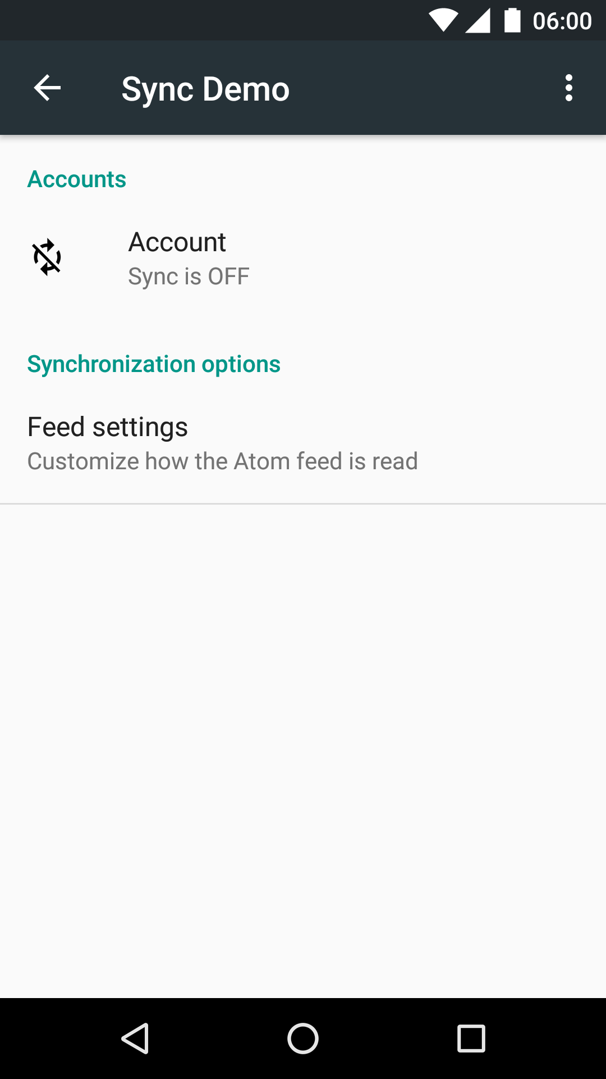
Bonus: Account preferences
res/xml/authenticator.xml
android:accountPreferences="@xml/account_preferences"
<account-authenticator xmlns:android="http://schemas.android.com/apk/res/android" android:accountPreferences="@xml/account_preferences" android:accountType="com.example.android.basicsyncadapter.account" android:label="@string/app_name"
android:icon="@drawable/ic_launcher" android:smallIcon="@drawable/ic_launcher"/>

Slide 45
Bonus: JobScheduler*
Can be used to trigger syncs on demand
Based on:
Network type
Charging state
Device idle state
Can run in the maintenance window of Doze mode**
* Android 5.0+
** Android 7.0+

Slide 46
Bonus: Schedulers
Schedulers can run background tasks
e.g. to trigger syncs on demand
Viable alternative to SyncAdapter approach
Based on:
Network type
Charging state
Device idle state
Can run in the maintenance window of Doze mode

Slide 47
Bonus: Schedulers
JobScheduler
Android SDK, API 22+
GcmNetworkManager
Google Cloud Messaging, API 9+ (soon API 14+)
JobDispatcher
Firebase, API 14+
AbstractThreadedSyncAdapter
Android SDK, API 5+
Notes:
Google Play Service 10 will support API 14+ (http://android-developers.blogspot.com/2016/11/google-play-services-and-firebase-for-android-will-support-api-level-14-at-minimum.html)
Choosing the right one: https://www.bignerdranch.com/blog/choosing-the-right-background-scheduler-in-android/

Slide 48


Slide 49
https://github.com/Pixplicity/sync-demo

Slide 50
https://github.com/googlesamples/android-BasicSyncAdapter
https://developer.android.com/training/sync-adapters/creating-sync-adapter.html
https://developer.android.com/training/sync-adapters/index.html
http://blog.udinic.com/2013/07/24/write-your-own-android-sync-adapter/
https://software.intel.com/en-us/android/articles/handling-offline-capability-and-data-sync-in-an-android-app-part-2
https://www.bignerdranch.com/blog/choosing-the-right-background-scheduler-in-android/

Slide 51
I’ve been doing some syncing…
Paul Lammertsma
CTO, Pixplicity

